Slide 1
Hoodlums and Saints

Slide 2
Introduction
We decided that the factors that determine the best neighborhood in Pittsburgh are based off the number of arrests and the number of playgrounds in those neighborhoods. The amount of playgrounds to arrests ratio typically determine the better neighborhood as the higher amount of playgrounds to arrest determine that the neighborhood is safe and has lower crime rate.

Slide 3
Arrest Data

Slide 4
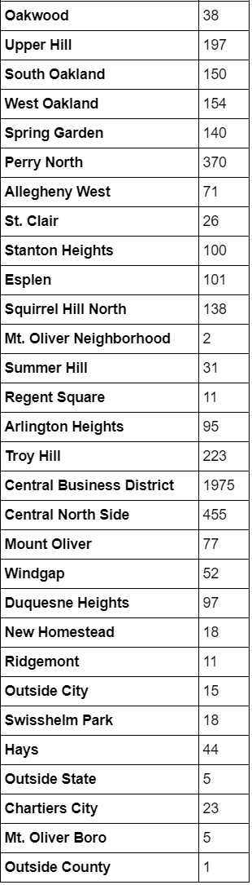
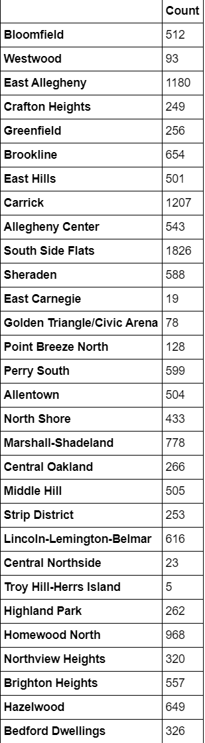
Number of arrests in each
Neighborhood

Slide 5
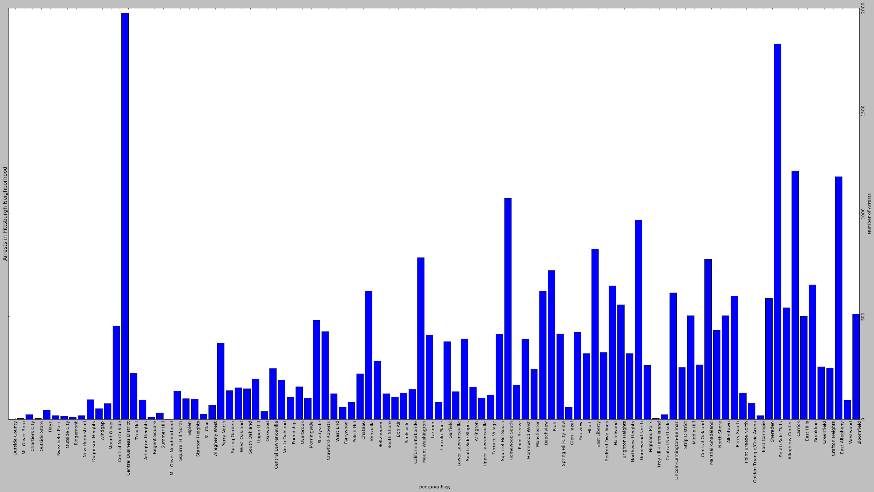
Number of Arrests

Slide 6
Data Analysis
What we gathered from this information was that the Central Business District neighborhood had the most amounts of arrests with 1975 while Outside County and Mt. Oliver Neighborhood have the two lowest amounts of arrests with 1 and 2.

Slide 7
Playground Data

Slide 8
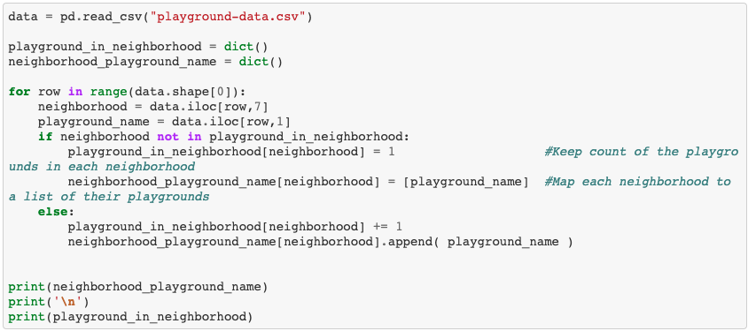
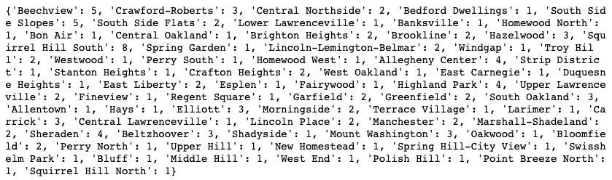
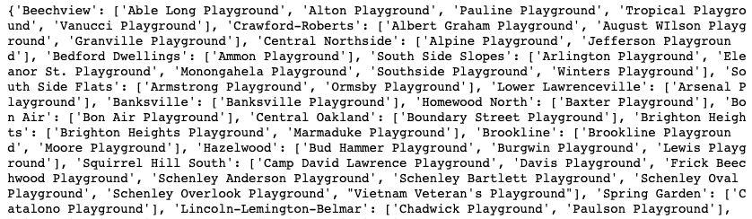
playground_in_neighborhood
neighborhood_playground_name

Slide 9
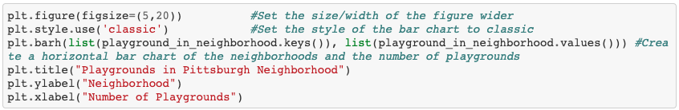
Script: Create Horizontal Bar Graph

Slide 10
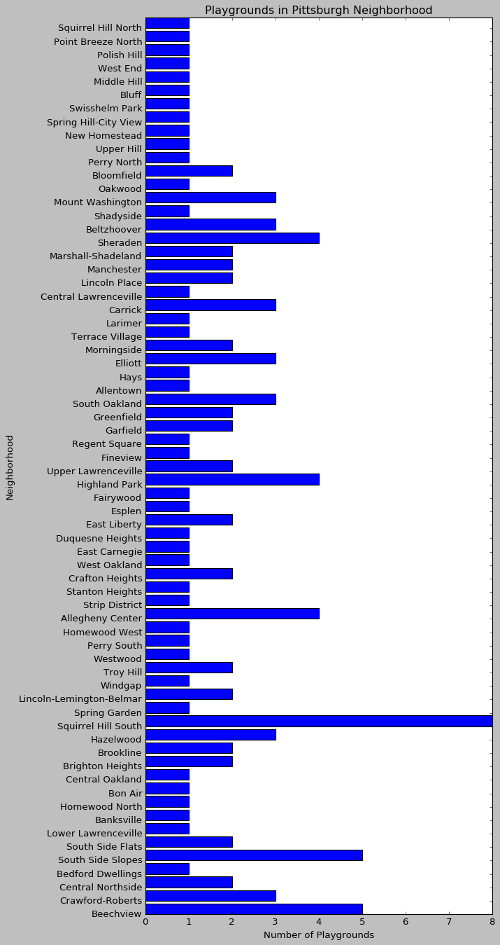
Numbers of playground

Slide 11
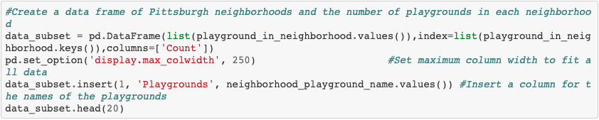
Script: Create a Table

Slide 12
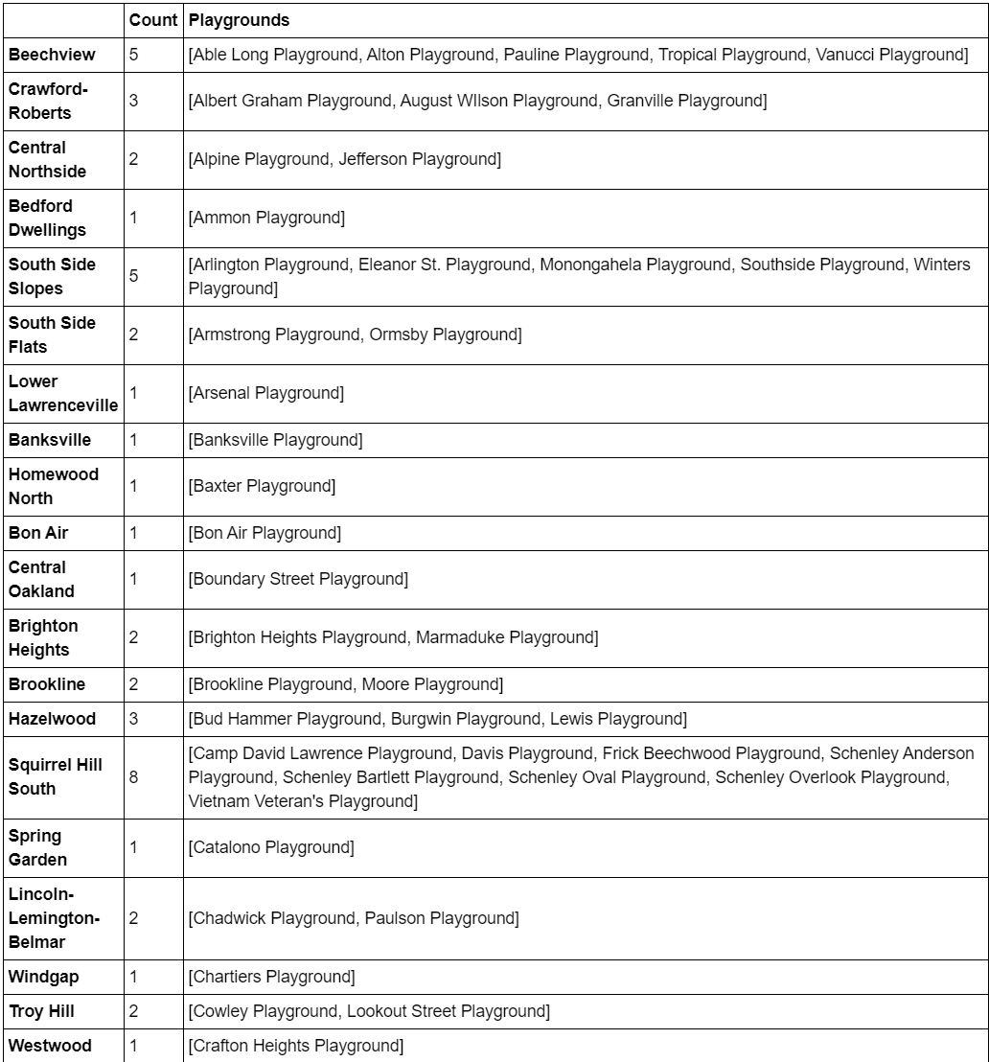
Number of playground
per neighborhood

Slide 13
Data Analysis
The neighborhoods with the most amount of playgrounds are Squirrel Hill South with 8, Beechview with 5, and Bedford Dwellings, Lower Lawrenceville, Banksville, Homewood North, Bon Air, Central Oakland, Spring Garden, Windgap , and Westwood all having only 1 playground.

